Slide 1


CMPE 272 ClassProject
- A Hiking advisor
Team 18:
Mingxuan Han
Teng Jin
Yu Fu

Slide 2
Team Members
Mingxuan Han
Teng Jin
Yu Fu

Slide 3

INTRO
Services
Future
Technique
End

Slide 4
Service
Location
View
Schedule
Review
Google API
Post Location
Organize
Rate

Slide 5
Steps
1
2
3
4
Step1
Step2
Step3
Step4
Siignup To active our service.
Users can select to be Guider or Tourist
Post any location with picture
Loop up location to join the hike
Review & rate

Slide 6


Slide 7

User

Slide 8
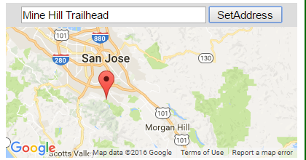
Location

Slide 9
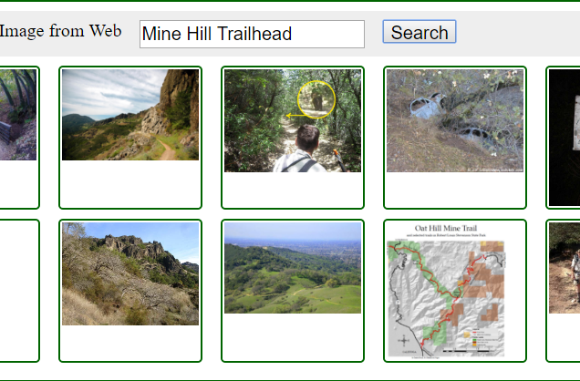
Viewable

Slide 10
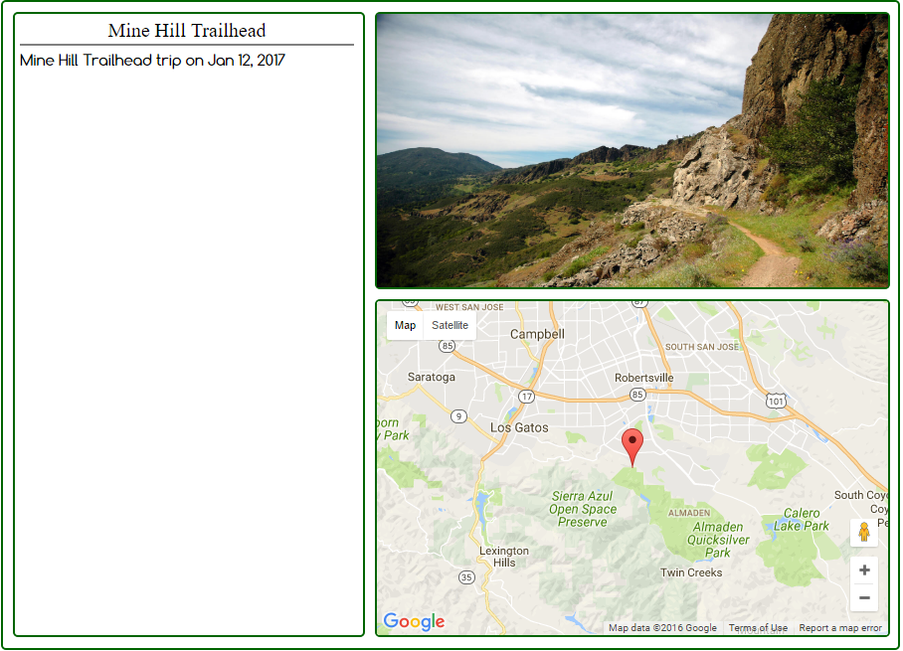

Slide 11
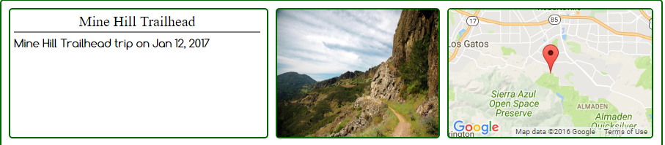
Schedule

Slide 12
Review & Rate

Slide 13
Technique
MEAN framework
RabbitMQ
MongoDB
IBM Bluemix

Slide 14

TimeLine
We Are Here
Future
Start up with idea about how to improve Hiker’s Free time
Basic Services
Like: Post, view, review and Rate
Add more services
Organize people
Tour group
Etc..

Slide 15
Reference
Java app built on Liberty, MongoDB, and IBM Bluemix locates highly rated businesses , IBM.
http://www.ibm.com/developerworks/cloud/library/cl-local-business-ratings-app/cl-local-business-ratings-app-pdf.pdf
GOOGLE API

